Slide 1






Alpa
Buddhabhatti
she/her
Lead Data Engineer
Microsoft MVP, Data Platform
Lead data Engineer
MCT
@alpabuddhabhatti
alpabuddhabhatti
alpaBuddhabhatti
@alpabuddhabhatti
alpabuddhabhatti
alpabuddhabhatti
Notes:
Peter

Slide 2

Day 1 Agenda
Introduction
Azure OpenAI Overview
Quick Tour Azure OpenAI
Break -10 minutes
4. Azure AI Search Overview
5. Quick Tour Azure AI Search
6. Lunch Break – 40 Minutes
7. Tools
8. Break -10 minutes
9. Labs
10. Conclusions
11. Q&A

Slide 3
Day 1: Introduction to Azure AI Services
Generative AI with Azure OpenAI
- Introduction to Azure OpenAI:
What is it & How it works
Benefits and use cases
Introduction to Tools and SDKs for Generative AI Development
Hands-on:
Creating your first Azure OpenAI instance
Testing Azure OpenAI
Applying Azure OpenAI to your data
Customizing Azure OpenAI

Slide 4
Day 1
Introductions

Slide 5
Day 1
Introduction to Azure OpenAI

Slide 6
What is Azure OpenAI
Azure AI service help you to apply generative AI on your data or Public data
Make you Apps more smart
Azure PaaS AI Service
Natural Language Processing Algorithm
Co-developed by Microsoft +OpenAI
Enterprise level security
Easy to consume it using Rest Endpoint and key

Slide 7
What Is Multi-Modal Azure AI
Process and understand information from various types of data sources simultaneously
For example, it can take both an image and a text description as input and generate a coherent response that considers both types of information.
Various formats(text, images, audio, and videos)
This makes it incredibly versatile and powerful.
GPT - 4o & GPT - 4o Mini

Slide 8
Few Examples
Apps (Q&A Or Chatbot)
Summarize your data
Ask natural language queries to your structured data
The automatic Code generation
Media analysis

Slide 9
Multi-Modal AI Model – Application
Healthcare: A doctor can upload an X-ray, and GPT-4o can help analyse it and suggest possible diagnoses.
Education: Teachers can use it to create interactive lessons, combining text, images, and videos.
Customer Service: It can help solve customer issues by understanding screenshots and providing detailed instructions.
Content Creation: Writers and marketers can generate images to accompany their articles, blogs, or social media posts, enhancing engagement.
Design and Art: Graphic designers and artists can use GPT-4.0 to quickly prototype visual ideas or find inspiration for new projects.

Slide 10
How to consume it ?
REST API (Endpoint , Key, etc)
Example:
curl $AZURE_OPENAI_ENDPOINT/openai/deployments/gpt-35-turbo-instruct/completions?api-version=2023-05-15 \
-H "Content-Type: application/json" \
-H "api-key: $AZURE_OPENAI_KEY" \
-d "{\"prompt\": \"Once upon a time\"}"

Slide 11







High Level Design
User
Private Data Sources
… etc
OR
Query
Response
Private Data
Knowledge
Public Data
OPEN DATA
20/01/2025
11

Slide 12

High Level Design
Private Data
Knowledge + Query
Response
OPEN DATA
Public Data

Slide 13
For Public Data using Azure Portal
User
Query: 2+2=?
Response
2+2=4
Open
Data
Knowledge
Public Data
(Data over internet )
20/01/2025
13

Slide 14

DEMO - Integrate Azure OpenAI with ADF
1. Azure OpenAI Rest URL+API API Version
2. Method : POST
3. Header : Content-Type +Key
4. Message : Prompt
Query: 2+2=?
Response
2+2=4
Open
Data
Knowledge
Public Data
(Data over internet )
20/01/2025
14

Slide 15

High Level Design
Knowledge
+ Query
Knowledge
3
Private Data
1
Query
4
2

Slide 16
Consuming – Azure OpenAI
Azure AI studio
Postman
Microsoft Fabric
VS Code
Azure OpenAI Rest URL
API Version
Model name
Method
Header (Content-Type +Key )
Message(Prompt )
How to use function calling with Azure OpenAI Service - Azure OpenAI Service | Microsoft Learn

Slide 17
Day 1
Short Break 1 (10 Minutes)

Slide 18
Day 1 : Tools

Slide 19
Prerequisites
Azure account.
Azure subscription with access enabled for the Azure OpenAI service.
You can request access with this form- Request Access to Azure OpenAI Service (microsoft.com)
3. Azure account permissions(subscription-level permissions OR RG level):
Microsoft.Authorization/roleAssignments/write permissions (such as Role Based Access Control Administrator, User Access Administrator, or Owner.)
Microsoft.Resources/deployments/write permissions on the subscription level.
You need App Registration (Client Id)

Slide 20
Tools
Azure OpenAI
Azure AI Search
Azure SQL
WebApp
Microsoft Fabric
Postman
Python
VS code

Slide 21
Links
AzureOpenAI/Local Env setup.docx at main · alpaBuddhabhatti/AzureOpenAI
Calling Azure OpenAI Programmatically: A Step-by-Step Guide -Part 1 | by alpa buddhabhatti | Medium
Calling Azure OpenAI Programmatically: A Step-by-Step Guide -Part 2 | by alpa buddhabhatti | Medium
How to use function calling with Azure OpenAI Service - Azure OpenAI Service | Microsoft Learn
Calling Azure OpenAI Programmatically: A Step-by-Step Guide -Part 2 | by alpa buddhabhatti | Medium

Slide 22
Day 1
Short Break 2 (40 Minutes)

Slide 23
Day 1
Introduction to Azure AI Services

Slide 24
What is Azure AI Search?
A cloud service that helps find and organize data.
Provides search features for applications.

Slide 25
Key Features
Search text, images, and documents.
Works with many data types (PDF, Word, Excel).
Uses AI to improve search results.

Slide 26
Why Use Azure AI Search
Find information quickly.
Easy to use and set up.
Works well with other Microsoft tools.

Slide 27
How It Works
Step 1: Add your files (PDF, Excel, etc.).
Step 2: Azure AI processes and organizes the data.
Step 3: Search and get results quickly.

Slide 28
Azure AI Search Workflow
1. Data ingestion from sources.
2. Indexing with cognitive search.
3. Query processing.
4. Response generation with Azure OpenAI.

Slide 29
Common Uses
Online shopping search.
Finding company documents.
Analyzing customer feedback.

Slide 30
Getting Started
1. Create an Azure AI Search Service.
2. Ingest data sources.
3. Define indexing strategy.
4. Implement search in application

Slide 31
Recap
Azure AI Search helps businesses find information easily.
It’s simple, fast, and smart.

Slide 32

Keywords
Large Language Models (LLMs) : Prebuild model ChatGPT and GPT-4
Token: A token is a piece of text that the model reads or writes.
For example, “hello” is one token, and “.” is another token.
Prompt: A prompt is the text that you give to the model as input.
For example, “Write a poem about love” is a prompt.
Completion: A completion is the text that the model gives you as output based on the prompt.
For example, “Love is a feeling that fills the heart / With joy and warmth and light” is a completion.

Slide 33
Keywords
Embedding: An embedding is a number that represents the meaning of the text. Or “a numerical representation of data” Or “a process that represents textual data (such as words or documents) into numeric vector”.
For example, the embedding of “cat” is closer to the embedding of “dog” than to the embedding of “car”.
Temperature: Temperature is a number that controls how creative or predictable the model’s output is.

Slide 34
Search Type
Parameter | Definition | Example
Keyword | A word or phrase that matches the content of your documents | “cat”
Semantic | A parameter that enables semantic ranking, captions, and answers for your search queries | “What is the best pet for me?”

Slide 35

Tips
Azure OpenAI:
Wait for some time
Refresh Azure OpenAI
Region
While consuming if you have
OpenAI ~ 0.28.1 or OpenAI >=1.0.0
How to use function calling with Azure OpenAI Service - Azure OpenAI Service | Microsoft Learn
Azure AI Search:
Select a plan of Semantic Search
Enable the service in your Service
Semantic Search
At list Basic Sku

Slide 36
Day 1 : Demos

Slide 37
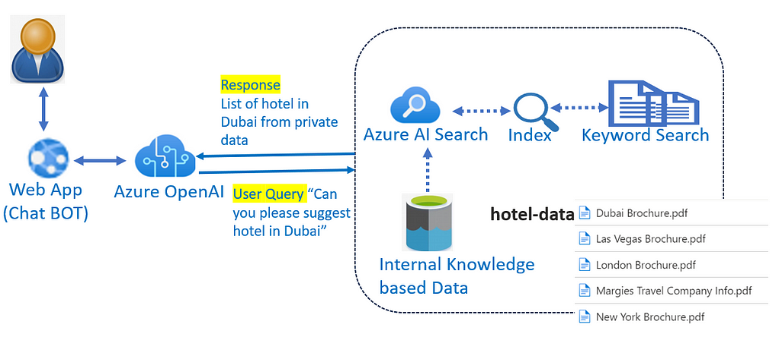

Slide 38


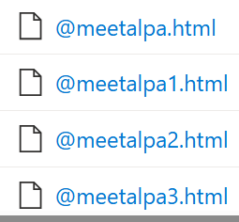

DEMO 2
Knowledgebase Q&A (Blog URL as Knowledge data source)
End-user as Paul
Azure OpenAI
Azure AI search
Azure WebApp
Azure Data Lake Gen2
User Query:
“What is ADF?
Response
“ADF is ….”
Azure AI Search
Index
Search
Medium Blogs as data
Web App
(Chat BOT)
Azure OpenAI
Internal Knowledge
based Data
Developer as Alpa

Slide 39
DEMO 3
Orchestrating Azure OpenAI with Azure Data Factory (ADF) for order delay notifications
Azure OpenAI
Azure Data Factory (Microsoft Fabric)
Azure SQL Database
Send Order Delay Notification
Internal Knowledge
based Data
Azure OpenAI

Slide 40

DEMO 3
Orchestrating Azure OpenAI with Azure SQL DB via VS code
Azure OpenAI
Azure SQL Database
Streamlit
VS code
Python
User Query : Show me Orders
Streamlit
Azure OpenAI
Select * from abo.Orders
Python
Database

Slide 41

High Level Design
Response
Search Query
Web App
(chat BOT)
Prompt
(Content Filtering)
Blocked Harmful Prompt
e.g. Social media like
Twitter, Slack App
Azure Function, Notebooks , C# code etc
Index
Azure OpenAI
Azure AI Search
Keyword Search
Internal Knowledge based Data

Slide 42
High Level Design
Search Query
Index
e.g. Social media like
Twitter, Slack App
Azure OpenAI
Azure AI Search
Keyword Search
Internal Knowledge based Data

Slide 43
High Level Design
Search Query
Index
Search Query
Azure OpenAI
Internal query Data
Azure AI Search
Keyword Search
Internal Knowledge based Data

Slide 44
Day 1 : Conclusions

Slide 45
Conclusion
Key takeaways and next steps
Azure OpenAI: Azure AI services enable you to apply natural language processing (NLP) to your own data or public data quickly and easily, making your applications smarter. It works with all kinds of data, including text, images, audio, and video.
Demo 1 – Shows how to integrate Azure OpenAI in various ways.
Demo 2 – Bring Your Own Data (BYOD) using Medium Blog source data
Demo 3 – Automates order delay notifications
Demo 4 – Natural language queries on structured databases.
You can use these ideas with your own data to build knowledge-based chat apps, generate documents like High-Level Designs (HLD), Requests for Proposals (RFP), and generate video, audio, and images, among other possibilities.

Slide 46
Day 1 : Q&A

